Slide 1
Challenges and Opportunities: How we Learn
Randall C. O’Reilly

Slide 2
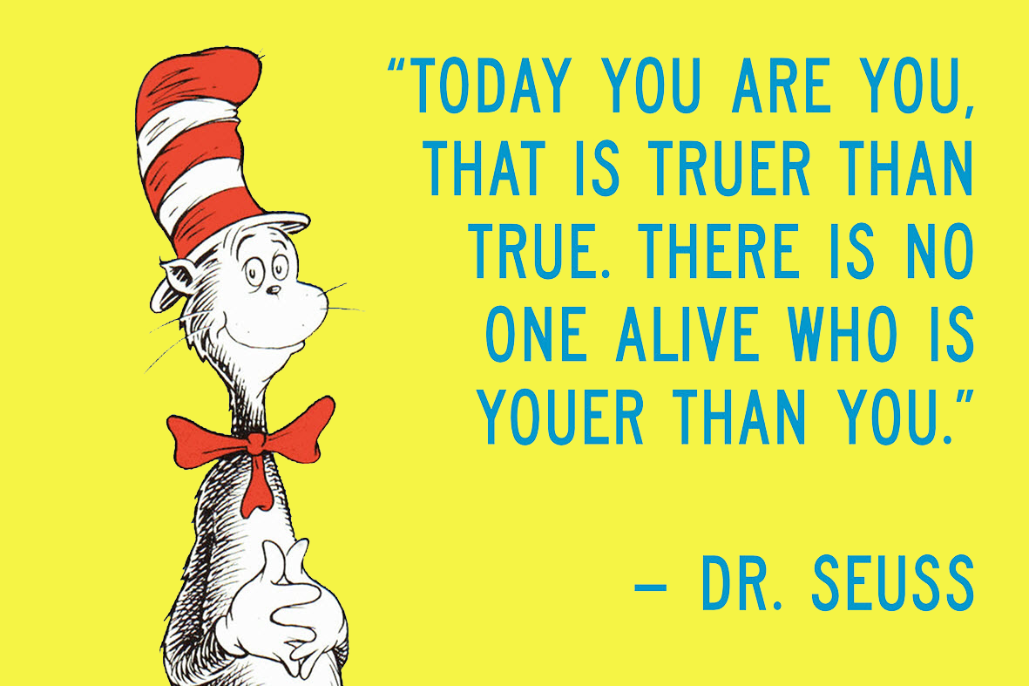
What Makes You, You?

Slide 3
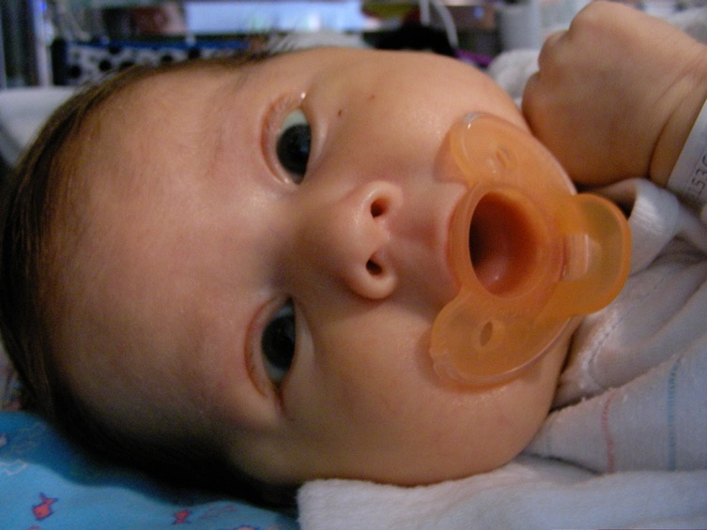
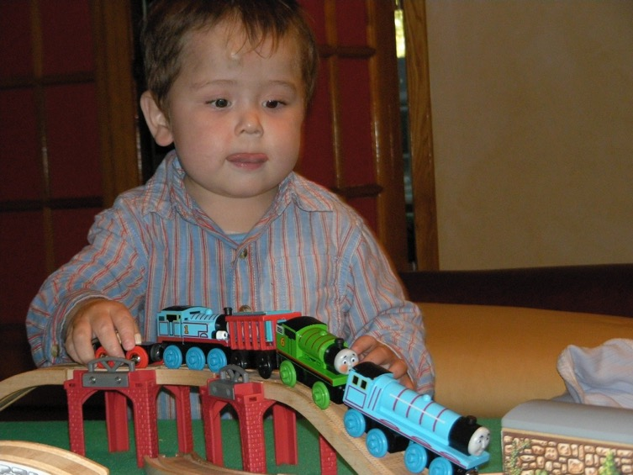
A Parent’s Perspective
Kids start out really, really… incapable (diapers for 2-3 years!?)
A core “personality” or “temperament” is there from the start..
But so much is learned..

Slide 4
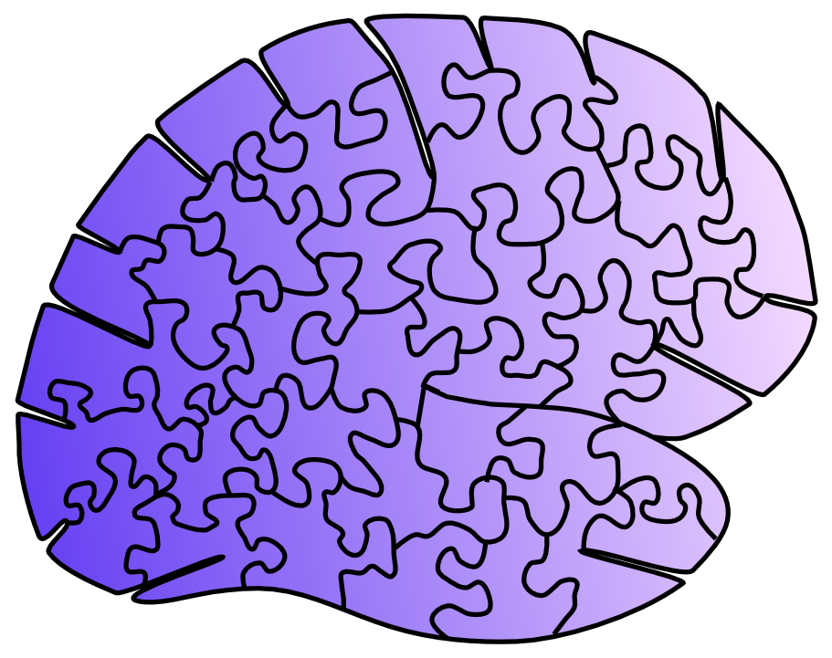
Learning is an embarrassment… of riches
It is embarrassing how little we know about learning in the one place that really matters: the neocortex.
We know more about most other brain areas:
Basal Ganglia, Cerebellum, Hippocampus..

Slide 5
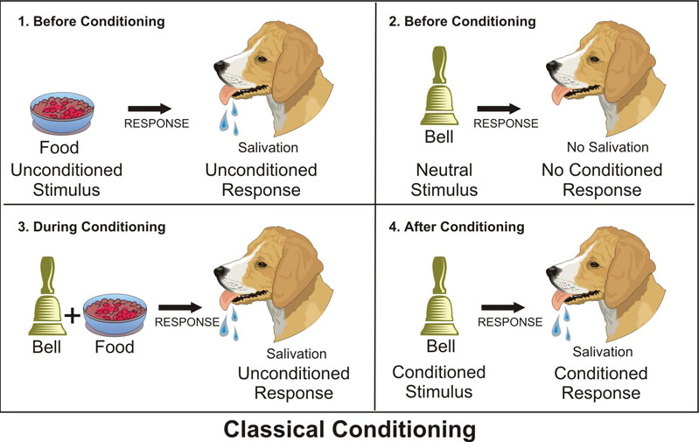
Textbooks are stuck in the 1950’s
US
UCR
CS
CR
and the cutting edge is not much better!

Slide 6
“What works”
Neuroscience
How do we get to “and”?

Slide 7
Not biological: error backpropagation
Not psychological (where is that hand when you need it!?)

Slide 8
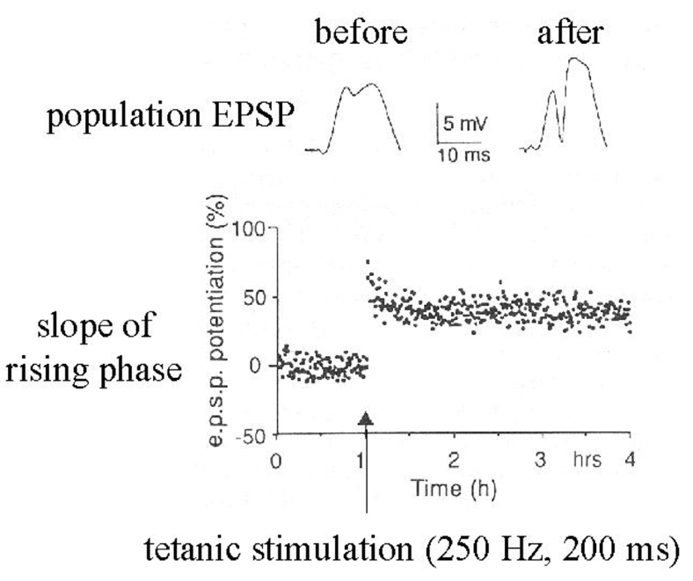
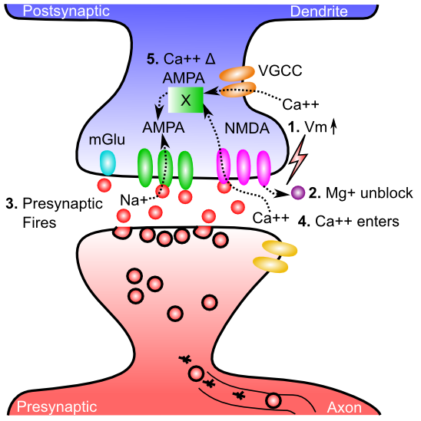
Neuroscience: Hebbian

Slide 9
Hebbian is too Dumb!
Babies exhibit some serious active, theory-like learning abilities!
Not just passive soaking up of statistics..

Slide 10
“What works”
Neuroscience
How do we get to “and”?

Slide 11
Any Ideas? Hypotheses?

Slide 12
Hypotheses are the Hypothesis!

Slide 13
We learn by constantly generating hypotheses or predictions about what will happen next!
Something always happens! Free lunch!

Slide 14
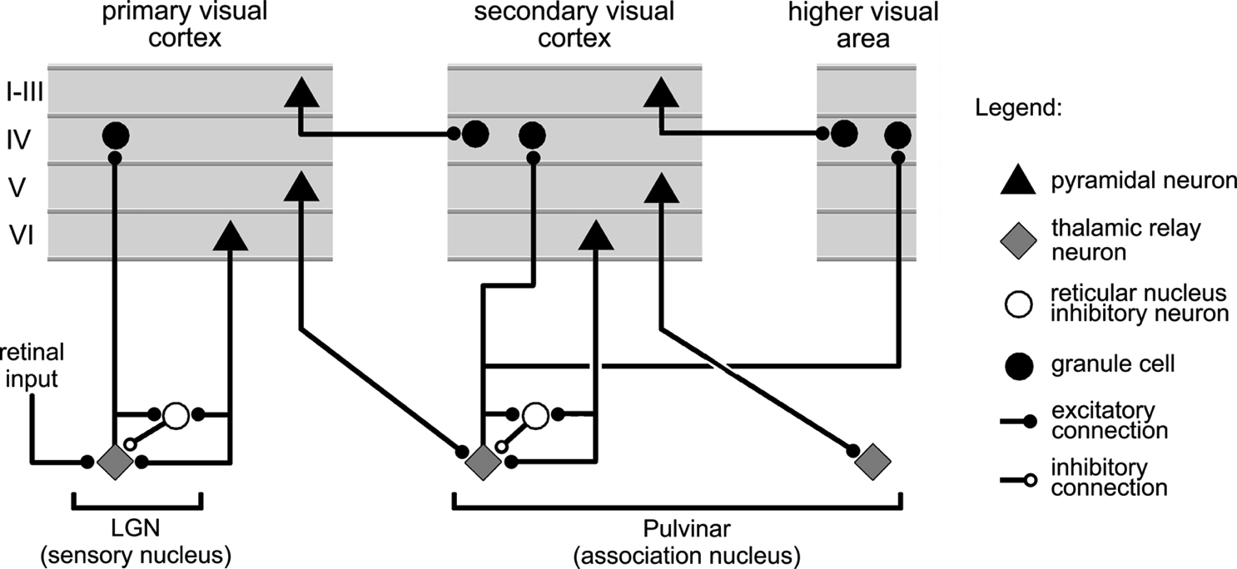
Thalamocortical Loop Biology (Sherman & Guillery, 2006)
5IB
FF
Driver
Weak
FB
“What happens”
Prediction

Slide 15
The Pulvinar = Projection Screen (c.f. Mumford, 1991 “blackboard”)
Pulvinar receives connections from all over visual cortex
and projects back out to these same areas
Two inputs:
1. Few strong feedforward:
“what happens”
2. Many weaker feedback:
prediction
Pulvinar!

Slide 16
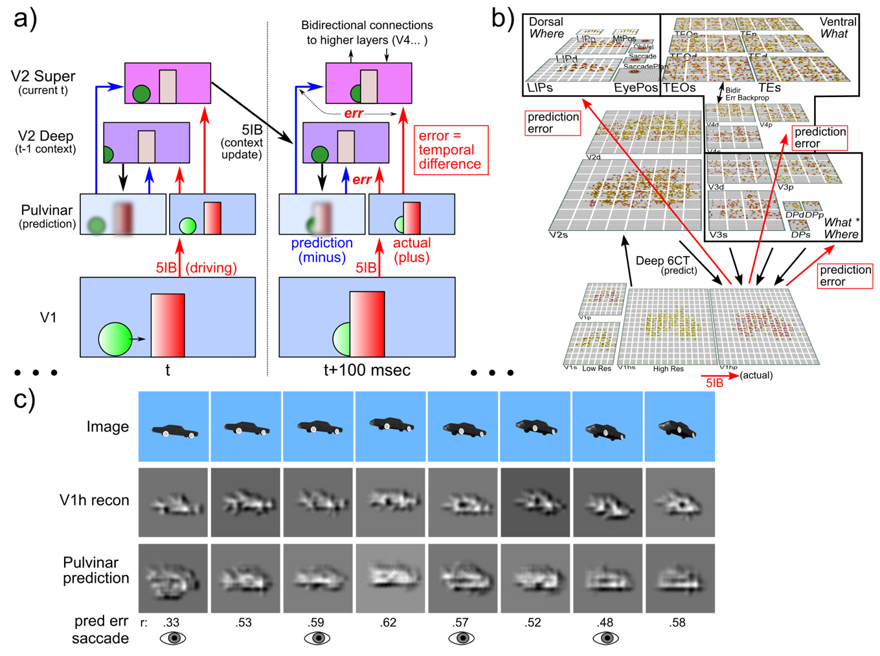
Deep Predictive Learning

Slide 17
Key Challenge
Can merely predicting low-level sensory inputs produce higher-level abstract representations?
If not, maybe we still need that hand??

Slide 18
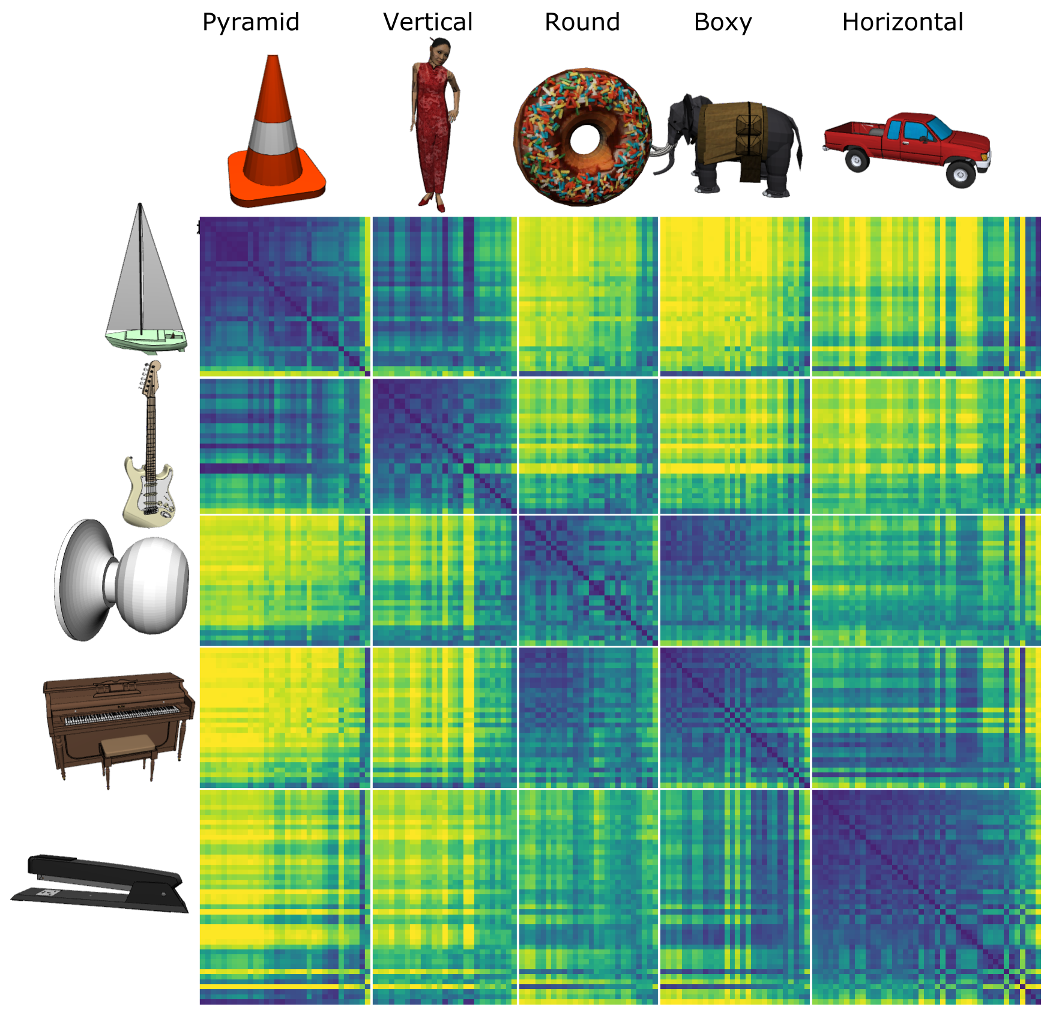
Model discovered
Shape categories!

Slide 19
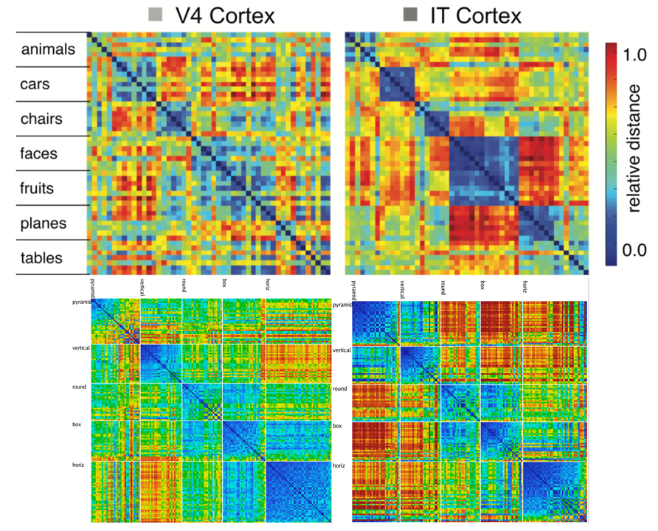
Model vs. Monkeys: Categories Emerge in Higher Layers

Slide 20
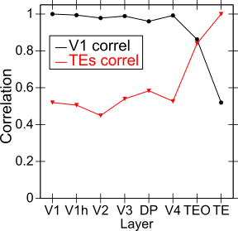
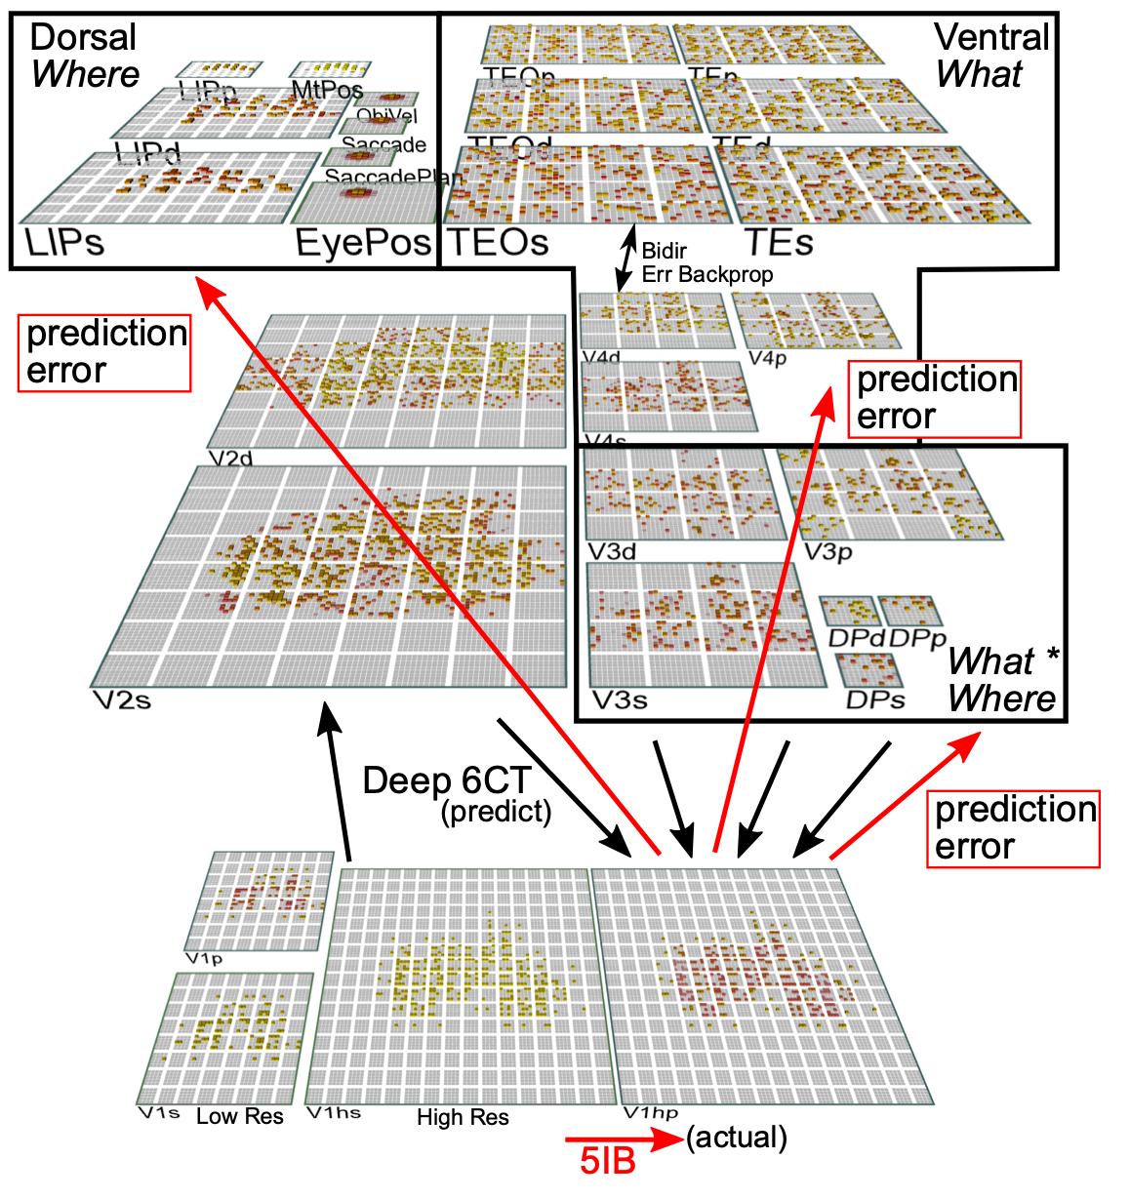
Categories not in V1; Emerge in IT Obj Rec Pathway

Slide 21
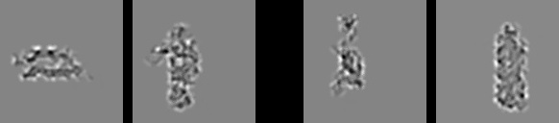
Model vs. Humans
Which pair is more similar in terms of overall shape?

Slide 22

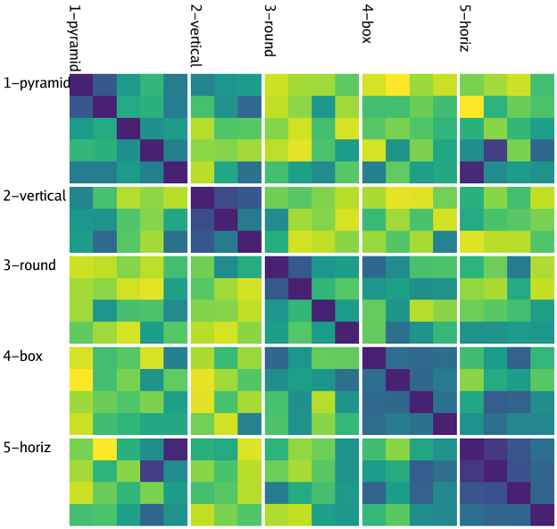
Model
People

Slide 23
“What works”
AND
Neuroscience
Deep predictive learning:
- Works
- Fits with lots of biology
- Extends to motor, cross-modal predictions

Slide 24
A Parent’s Perspective
Kids start out really, really… incapable (diapers for 2-3 years!?)
A core “personality” or “temperament” is there from the start..
But so much is learned..

Slide 25
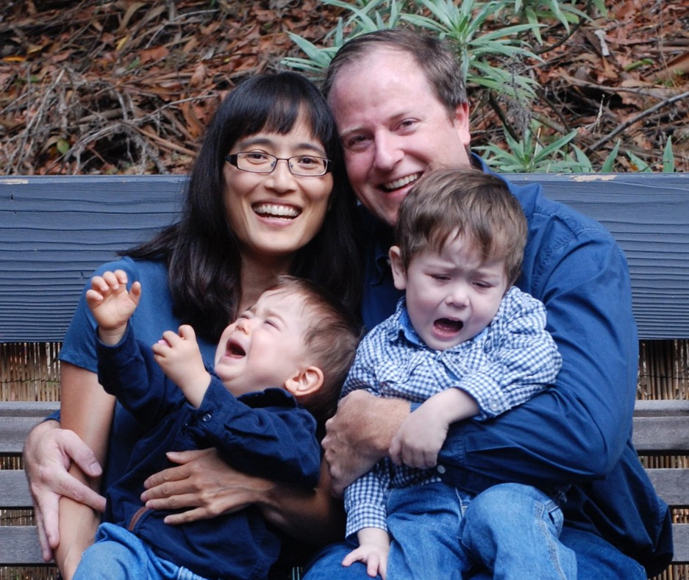
Motivating Question: What drives us to learn?
Tantrums!!!

Slide 26
My Future…
My goal is to make a model that throws tantrums, and talks back to me with the same kind of attitude I get from my kids (now 13 and 11)!
Then I will know I’ve captured the “scream power” that really drives human learning.

Slide 27
Your Future…

Slide 28
Human Cognition is still the #1 Problem and #1 Solution!

Slide 29
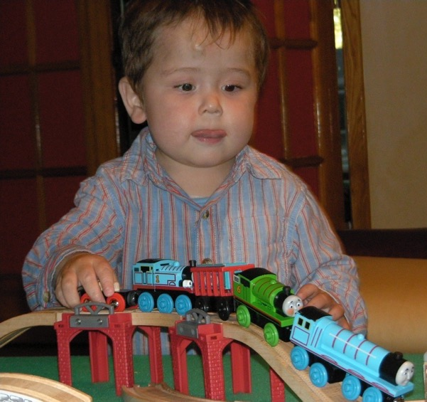
Greed is Good!
Greed propels people ever onward and upward!
We are greedy for knowledge…

Slide 30
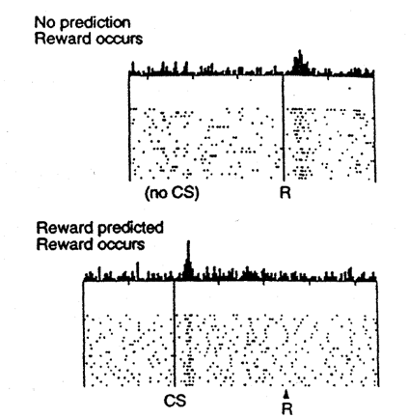

Learning is Greedy
Dopamine!
At each level, mastery = predicted success = no more dopamine. We always want more DA!

Slide 31
Your Future!

Slide 32
Thank you!
For listening…
And for saving the world!

